Slide 1
Module-4(Part-1)
Algorithms and Decision Procedures for CFLs: Decidable questions, Un-decidable questions.

Slide 2
Algorithms and Decision Procedures for Context-Free Languages
Chapter 14

Slide 3
Decision Procedures for CFLs
Membership: Given a language L and a string w, is w in L?
Two approaches:
● If L is context-free, then there exists some context-free
grammar G that generates it. Try derivations in G and see
whether any of them generates w.
Problem:
● If L is context-free, then there exists some PDA M that
accepts it. Run M on w.
Problem:

Slide 4
Decision Procedures for CFLs
Membership: Given a language L and a string w, is w in L?
Two approaches:
● If L is context-free, then there exists some context-free
grammar G that generates it. Try derivations in G and see
whether any of them generates w.
S → S T | a S Try to derive aaa
S T
S T

Slide 5
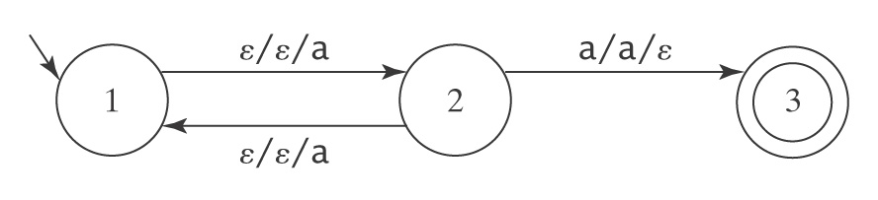
Decision Procedures for CFLs
Membership: Given a language L and a string w, is w in L?
Two approaches:
● If L is context-free, then there exists some context-free
grammar G that generates it. Try derivations in G and see
whether any of them generates w.
Problem:
● If L is context-free, then there exists some PDA M that
accepts it. Run M on w.
Problem:

Slide 6
Using a Grammar
decideCFLusingGrammar(L: CFL, w: string) =
1. If given a PDA, build G so that L(G) = L(M).
2. If w = ε then if S_{G} is nullable then accept, else reject.
3. If w ≠ ε then:
3.1 Construct G′ in Chomsky normal form such that
L(G′) = L(G) – {ε}.
3.2 If G derives w, it does so in 2⋅|w| - 1 steps. Try all
derivations in G of 2⋅|w| - 1 steps. If one of them
derives w, accept. Otherwise reject.

Slide 7
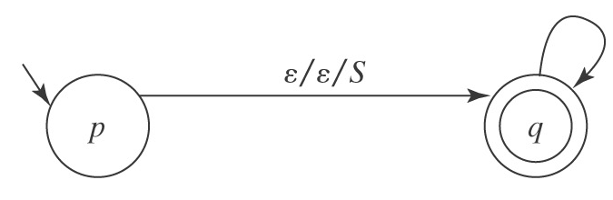
Using a PDA
Recall CFGtoPDAtopdown, which built:
M = ({p, q}, Σ, V, Δ, p, {q}), where Δ contains:
● The start-up transition ((p, ε, ε), (q, S)).
● For each rule X → s₁s₂…s_{n}. in R, the transition ((q, ε, X), (q,
s₁s₂…s_{n})).
● For each character c ∈ Σ, the transition ((q, c, c), (q, ε)).
Can we make this work so there are no ε-transitions? If every transition consumes an input character then M would have to halt after |w| steps.

Slide 8
Greibach Normal Form
All rules are of the following form:
● X → a A, where a ∈ Σ and A ∈ (V - Σ)*.
No need to push the a and then immediately pop it.
So M = ({p, q}, Σ, V, Δ, p, {q}), where Δ contains:
1. The start-up transitions:
For each rule S → cs₂…s_{n}, the transition:
((p, c, ε), (q, s₂…s_{n})).
2. For each rule X → cs₂…s_{n} (where c ∈ Σ and s₂
through s_{n} are elements of V - Σ), the transition:
((q, c, X), (q, s₂…s_{n}))

Slide 9
A PDA Without ε-Transitions Must Halt
Consider the execution of M on input w:
● Each individual path of M must halt within |w| steps.
● The total number of paths pursued by M must be
less than or equal to P = B^{|w|}, where B is the
maximum number of competing transitions from
any state in M.
● The total number of steps that will be executed by
all paths of M is bounded by P ∗ |w|.
So all paths must eventually halt.

Slide 10
An Algorithm to Decide Whether M Accepts w
decideCFLusingPDA(L: CFL, w: string) =
1. If L is specified as a PDA, use PDAtoCFG to construct a
grammar G such that L(G) = L(M).
2. If L is specified as a grammar G, simply use G.
3. If w = ε then if S_{G} is nullable then accept, otherwise reject.
4. If w ≠ ε then:
4.1 From G, construct G′ such that L(G′) = L(G) – {ε} and
G′ is in Greibach normal form.
4.2 From G′ construct a PDA M such that L(M) = L(G′)
and M′ has no ε-transitions.
4.3 All paths of M are guaranteed to halt within a finite
number of steps. So run M on w. Accept if it accepts
and reject otherwise.

Slide 11
Emptiness
Given a context-free language L, is L = ∅?

Slide 12
Emptiness
Given a context-free language L, is L = ∅?
decideCFLempty(G: context-free grammar) =
1. Let G′ = removeunproductive(G).
2. If S is not present in G′ then return True
else return False.

Slide 13
Finiteness
Given a context-free language L, is L infinite?
decideCFLinfinite(G: context-free grammar) =
1. Lexicographically enumerate all strings in Σ* of length
greater than b^{n} and less than or equal to b^{n+1} + b^{n}.
2. If, for any such string w, decideCFL(L, w) returns True
then return True. L is infinite.
3. If, for all such strings w, decideCFL(L, w) returns False
then return False. L is not infinite.
Why these bounds?

Slide 14
Equivalence of DCFLs
Theorem: Given two deterministic context-free languages
L₁ and L₂, there exists a decision procedure to determine
whether L₁ = L₂?
Proof: Given in [Sénizergues 2001].

Slide 15
The Undecidable Questions about CFLs
● Is L = Σ*?
● Is the complement of L context-free?
● Is L regular?
● Is L₁ = L₂?
● Is L₁ ⊆ L₂?
● Is L₁ ∩ L₂ = ∅?
● Is L inherently ambiguous?
● Is G ambiguous?

Slide 16
MODULE-4 (part-2) Turing Machines
Turing Machine: Turing machine model, Representation, Language acceptability by TM, design of TM, Techniques for TM construction. Variants of Turing Machines (TM), The model of Linear Bounded automata.

Slide 17
Turing Machines are…
Very powerful (abstract) machines that could simulate any modern day computer (although very, very slowly!)
Why design such a machine?
If a problem cannot be “solved” even using a TM, then it implies that the problem is undecidable
Computability vs. Decidability
For every input, answer YES or NO

Slide 18
A Turing Machine (TM)
This is like the CPU & program counter
M = (Q, ∑, Γ, δ, q₀,B,F)
Finite
control
Tape is the memory
Tape head
Infinite tape with tape symbols
…
B | B | B | X₁ | X₂ | X₃ | … | X_{i} | … | X_{n} | B | B
…
Input & output tape symbols
B: blank symbol (special symbol reserved to indicate data boundary)

Slide 19
Transition function
You can also use:
➔ for R
⬅ for L
One move (denoted by |---) in a TM does the following:
δ(q,X) = (p,Y,D)
q is the current state
X is the current tape symbol pointed by tape head
State changes from q to p
After the move:
X is replaced with symbol Y
If D=“L”, the tape head moves “left” by one position. Alternatively, if D=“R” the tape head moves “right” by one position.
X / Y,D
q
p

Slide 20
ID of a TM
Instantaneous Description or ID :
X₁X₂…X_{i-1}qX_{i}X_{i+1}…X_{n}
means:
q is the current state
Tape head is pointing to X_{i}
X₁X₂…X_{i-1}X_{i}X_{i+1}…X_{n} are the current tape symbols
δ(q,X_{i}) = (p,Y,R) is same as:
X₁…X_{i-1}qX_{i}…X_{n} |---- X₁…X_{i-1}YpX_{i+1}…X_{n}
δ(q,X_{i}) = (p,Y,L) is same as:
X₁…X_{i-1}qX_{i}…X_{n} |---- X₁…pX_{i-1}YX_{i+1}…X_{n}

Slide 21
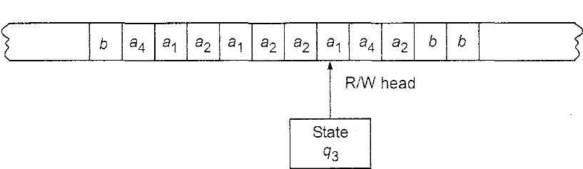
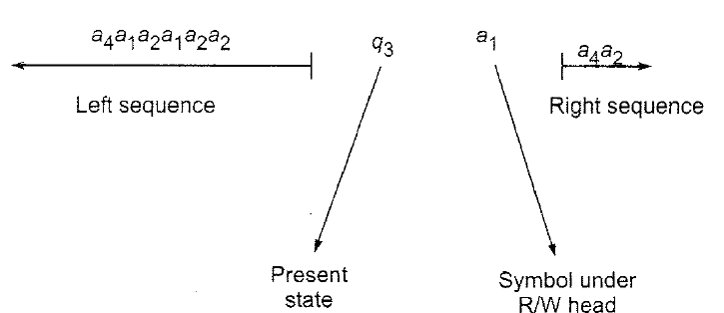
INSTANTANEOUS DESCRIPTIONS EXAMPLE
A snapshot of Turing machine is shown in below Fig.
The ID is as given in below Fig..

Slide 22
Way to check for Membership
Is a string w accepted by a TM?
Initial condition:
The (whole) input string w is present in TM, preceded and followed by infinite blank symbols
Final acceptance:
Accept w if TM enters final state and halts
If TM halts and not final state, then reject

Slide 23
EXAMPLE 1
Design a TM that accepts {0^{n}1^{n} | n≥ 1}
Solution:
We require the following moves:
If the leftmost symbol in the given input string w is 0, replace it by x and move right till we encounter a leftmost 1 in w. Change it to y and move backwards.
(b) Repeat (a) with the leftmost 0. If we move back and forth and
no 0 or 1 remains. move to a final state.
(c) For strings not in the form 0^{n}1^{n}, the resulting state has to be
non-final.

Slide 24
Example: L = {0^{n}1^{n} | n≥1}
Strategy: w = 000111
…
B
B
0
0
0
1
1
1
B
B
…
…
B
B
X
X
0
Y
Y
1
B
B
…
…
…
…
B
B
X
0
0
1
1
1
B
B
…
B
B
X
X
X
Y
Y
1
B
B
…
…
…
…
B
B
X
0
0
Y
1
1
B
B
…
B
B
X
X
X
Y
Y
Y
B
B
…
…
…
B
B
X
X
0
Y
1
1
B
B
…
B
B
X
X
X
Y
Y
Y
B
B
…
Accept

Slide 25
TM for {0^{n}1^{n} | n≥1}
*state diagram representation preferred
 | Next Tape Symbol
Curr. State | 0 | 1 | X | Y | B
q₀ | (q₁,X,R) | - | - | (q₃,Y,R) | -
q₁ | (q₁,0,R) | (q₂,Y,L) | - | (q₁,Y,R) | -
q₂ | (q₂,0,L) | - | (q₀,X,R) | (q₂,Y,L) | -
q₃ | - | - | - | (q₃,Y,R) | (q₄,B,R)
*q₄ | - | -- | - | - | -
Table representation of the state diagram

Slide 26
we construct a TM M as follows:
M = (Q, Σ,𝚪, 𝛅, q₀ ,b, F)
Q = {q₀, q_{1,} q_{2,} q_{3,} q_{f}}
F = {q_{f} }
Σ = { 0,1}
𝚪 = { 0,1,x,y,b}

Slide 27
TM for {0^{n}1^{n} | n≥1}
Y / Y,R
Mark next unread 0 with X and move right
Move to the right all the way to the first unread 1, and mark it with Y
Move back (to the left) all the way to the last marked X, and then move one position to the right
If the next position is 0, then goto step 1. Else move all the way to the right to ensure there are no excess 1s. If not move right to the next blank symbol and stop & accept.
0 / 0,R
0 / X,R
q₀
q₁
Y / Y,R
1 / Y,L
X / X,R
q₂
Y / Y,R
q₃
B / B,R
Y / Y,L
0 / 0,L
q₄

Slide 28
Computation sequence of 0011:
0
1
y
y
x
x
1
b
b
0
x
x
R/W head
R/W head
R/W head
R/W head
R/W head
R/W head
R/W head
R/W head
R/W head
R/W head
R/W head
R/W head
R/W head
R/W head
q₀
q₂
q₃
q₄
q₂
q₀
q₁
q₀
q₁
q₁
q₂
q₁
q₂
q₃
of 0011
q₀0011
⊢ xq₁011
⊢ x0q₁11
⊢ xq₂0y1
⊢ q₂x0y1
⊢xq₀0y1
⊢ xxq₁y1
⊢ xxyq₁1
⊢ xxq₂yy
⊢ xq₂xyy
⊢ xxq₀yy
⊢ xxyq₃y
⊢ xxyyq₃
= xxyyq₃b
⊢xxyybq₄b
q₄ is final state, hence 0011 is accepted by M

Slide 29
TMs for calculations
TMs can also be used for calculating values
Like arithmetic computations
Eg., addition, subtraction, multiplication, etc.

Slide 30
Example 1: Addition
The numbers are represented in unary format.
In unary format a number is represented by either all ones or all zeroes.
For adding 2 numbers using a Turing machine, both these numbers are given as input to the Turing machine separated by a “c”.
Examples – (2 + 3) will be given as 0 0 c 0 0 0:

Slide 31
Example 1: Addition
Step-1: Convert 0 into X and goto step 2. If symbol is “c” then convert it into blank(B), move right and goto step-6.
Step-2: Keep ignoring 0’s and move towards right. Ignore “c”, move right and goto step-3.
Step-3: Keep ignoring 0’s and move towards right. Convert a blank(B) into 0, move left and goto step-4.
Step-4: Keep ignoring 0’s and move towards left. Ignore “c”, move left and goto step-3.
Step-5: Keep ignoring 0’s and move towards left. Ignore an X, move left and goto step-1.
Step-6: End.

Slide 32
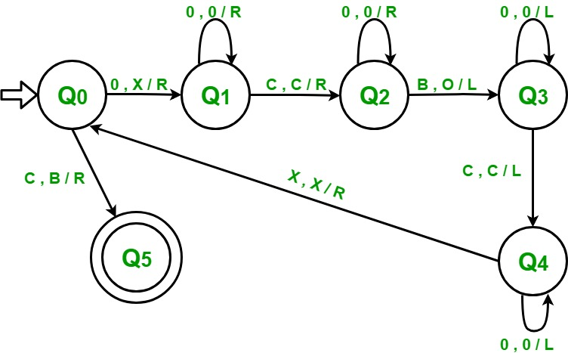
Example 1: Addition

Slide 33
Example 2: Subtraction
“m -- n” = max{m-n,0}
0^{m}10^{n} ➔ ...B 0^{m-n} B.. (if m>n) ...BB…B.. (otherwise)
For every 0 on the left (mark X), mark off a 0 on the right (mark Y)
Repeat process, until one of the following happens:
// No more 0s remaining on the left of 1 Answer is 0, so flip all excess 0s on the right of 1 to Bs (and the 1 itself) and halt
//No more 0s remaining on the right of 1 Answer is m-n, so simply halt after making 1 to B
Give state diagram

Slide 34
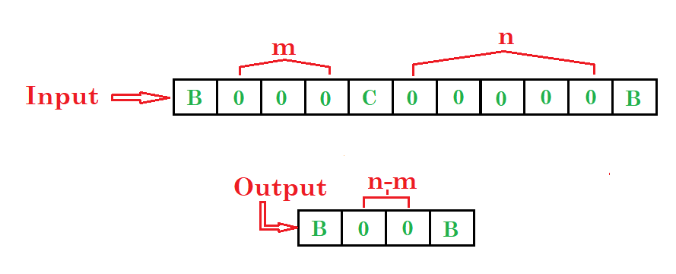
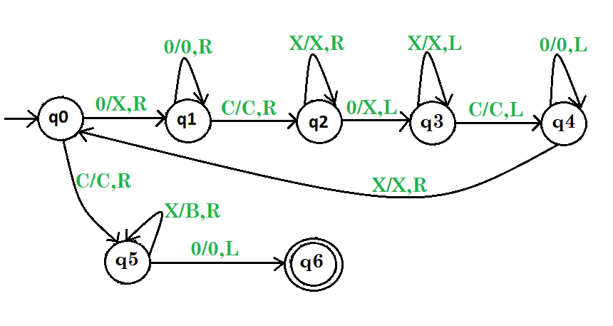
Example 2: Subtraction

Slide 35
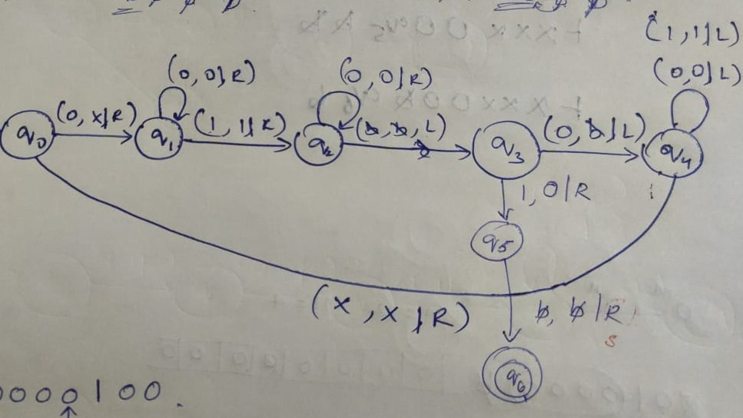
Example 2: Subtraction

Slide 36
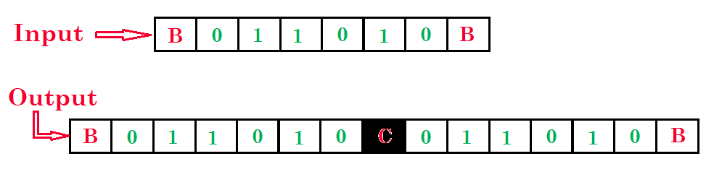
Turing Machine for copying data
Refer Class Notes for the transition diagram

Slide 37
Example 3: Multiplication
0^{m}10^{n}1 (input), 0^{mn}1 (output)
Pseudocode:
Move tape head back & forth such that for every 0 seen in 0^{m}, write n 0s to the right of the last delimiting 1
Once written, that zero is changed to B to get marked as finished
After completing on all m 0s, make the remaining n 0s and 1s also as Bs
Give state diagram
Refer Class Notes for the transition diagram

Slide 38
Exercises
Construct a DTM for each of the following.
{w | w is in {0,1}* and w ends in 00}
{w | w is in {0,1}* and w contains at least two 0’s}
{w | w is in {0,1}* and w contains at least one 0 and one 1}

Slide 39
Techniques for constructing Turing machine

Slide 40
Techniques for constructing Turing machine
Turing Machine with Stationary Head
Storage in the State
Multiple Track Turing Machine
Subroutines

Slide 41
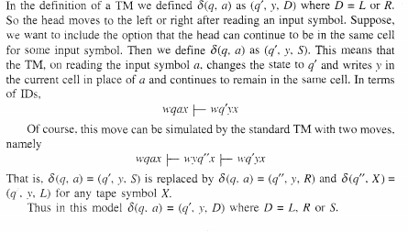
Turing Machine with Stationary Head

Slide 42

Turing Machines with Stay-Option
The head can stay in the same position
Left, Right, Stay
L,R,S: moves

Slide 43
Example:
Time 1
Time 2

Slide 44
Theorem:
Stay-Option Machines
have the same power as
Standard Turing machines

Slide 45
Proof:
Part 1: Stay-Option Machines
are at least as powerful as
Standard machines
Proof: a Standard machine is also
a Stay-Option machine
(that never uses the S move)

Slide 46
Proof:
Part 2: Standard Machines
are at least as powerful as
Stay-Option machines
Proof:
a standard machine can simulate
a Stay-Option machine

Slide 47
Stay-Option Machine
Simulation in Standard Machine
Similar for Right moves

Slide 48
Stay-Option Machine
Simulation in Standard Machine
For every symbol

Slide 49
Example
Stay-Option Machine:
1
2
Simulation in Standard Machine:
1
2
3

Slide 50

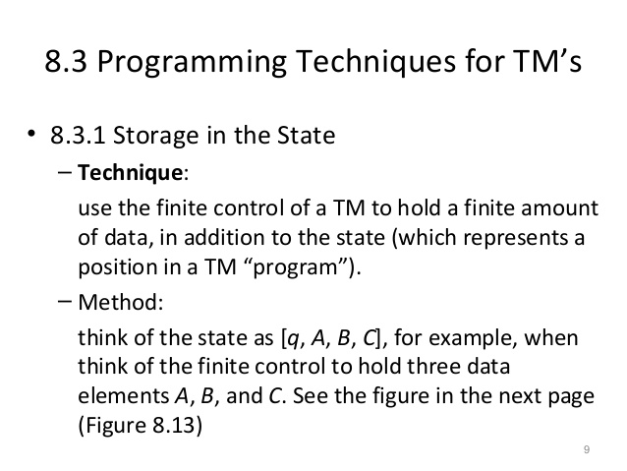
Storage in the State

Slide 51
TMs with storage
Generic description
Will work for both a=0 and a=1
E.g., TM for 01* + 10*
Current Storage symbol
Tape symbol
Next state
Current state
New Storage symbol
q
Transition function δ:
δ([q₀,B],a) = ([q₁,a], a, R)
δ([q₁,a],a) = ([q₁,a], a, R)
δ([q₁,a],B) = ([q₂,B], B, R)
storage
Tape head
B
B
0
1
1
1
1
1
B
B
…
Are the standard TMs
equivalent to TMs with storage?
Yes
[q,a]:
where q is current state,
a is the symbol in storage

Slide 52
Standard TMs are equivalent to TMs with storage - Proof
Claim: Every TM w/ storage can be simulated by a TM w/o storage as follows:
For every [state, symbol] combination in the TM w/ storage:
Create a new state in the TM w/o storage
Define transitions induced by TM w/ storage
Since there are only finite number of states and symbols in the TM with storage, the number of states in the TM without storage will also be finite

Slide 53
Multi-track Turing Machines
TM with multiple tracks, but just one unified tape head
control
One tape head to read k symbols from the k tracks at one step.
Track 1
…
…
…
…
Track 2
…
…
Track k
…
…

Slide 54
Multi-Track TMs
TM with multiple “tracks” but just one head
E.g., TM for {wcw | w∈ {0,1}* } but w/o modifying original input string
BEFORE
control
AFTER
control
Tape head
Tape head
…
B
B
0
1
0
c
0
1
0
B
…
Track 1
…
B
B
0
1
0
c
0
1
0
B
…
Track 1
…
B
B
B
B
B
B
B
B
B
B
…
Track 2
…
B
B
X
X
X
c
Y
Y
Y
B
…
Track 2
Second track mainly used as a scratch space for marking

Slide 55
Multi-track TMs are equivalent to basic (single-track) TMs
Let M be a single-track TM
M = (Q, ∑, Γ, δ, q₀,B,F)
Let M’ be a multi-track TM (k tracks)
M’ = (Q’, ∑ ’, Γ’, δ’, q’₀,B,F’)
δ’(q_{i},<a₁,a₂,…a_{k}>) = (q_{j}, <b₁,b₂,…b_{k}>, L/R)
Claims:
For every M, there is an M’ s.t. L(M)=L(M’).
(proof trivial here)

Slide 56
Multi-track TM ==> TM (proof)
For every M’, there is an M s.t. L(M’)=L(M).
M = (Q, ∑, Γ, δ, q₀,[B,B,…],F)
Where:
Q = Q’
∑ = ∑ ‘ x ∑ ‘ x … (k times for k-track)
Γ = Γ’ x Γ’ x … (k times for k-track)
q₀ = q’₀
F = F’
δ(q_{i},[a₁,a₂,…a_{k}]) = δ’(q_{i}, <a₁,a₂,…a_{k}>)
Multi-track TMs are just a different way to represent single-track TMs, and is a matter of design convenience.
Main idea:
Create one composite symbol to represent every combination of
k symbols

Slide 57
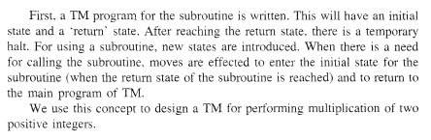
Subroutines
Refer Class Notes for the transition diagram

Slide 58
Variants of Turing Machines

Slide 59
Turing Machine Variants
There are many variations we can make to the basic TM
Extensions can make it useful to prove a theorem or perform some task
However, these extensions do not add anything extra the basic TM can’t already compute
Example: consider a variation to the Turing machine where we have the option of staying put instead of forcing the tape head to move left or right by one cell.
In the old model, we could replace each “stay put” move in the new machine with two transitions, one that moves right and one that moves left, to get the same behavior.

Slide 60
Multitape Turing Machines
A multitape Turing machine is like an ordinary TM but it has several tapes instead of one tape.
Initially the input starts on tape 1 and the other tapes are blank.
The transition function is changed to allow for reading, writing, and moving the heads on all the tapes simultaneously.
This means we could read on multiples tape and move in different directions on each tape as well as write a different symbol on each tape, all in one move.

Slide 61
Multi-tape Turing Machines
TM with multiple tapes, each tape with a separate head
Each head can move independently of the others
control
k separate heads
Tape 1
…
…
…
…
Tape 2
…
Tape k
…
…

Slide 62
On how a Multi-tape TM would operate
Initially:
The input is in tape #1 surrounded by blanks
All other tapes contain only blanks
The tape head for tape #1 points to the 1st symbol of the input
The heads for all other tapes point at an arbitrary cell (doesn’t matter because they are all blanks anyway)
A move:
Is a function (current state, the symbols pointed by all the heads)
After each move, each tape head can move independently (left or right) of one another

Slide 63
Multitape Turing Machine
Theorem: A multitape TM is equivalent in power to an ordinary TM. Recall that two TM’s are equivalent if they recognize the same language. We can show how to convert a multitape TM, M, to a single tape TM, S:
Say that M has k tapes.
Create the TM S to simulate having k tapes by interleaving the information on each of the k tapes on its single tape
Use a new symbol # as a delimiter to separate the contents of each tape
S must also keep track of the location on each of the simulated heads
Write a type symbol with a * to mark the place where the head on the tape would be
The * symbols are new tape symbols that don’t exist with M
The finite control must have the proper logic to distinguish say, x* and x and realize both refer to the same thing, but one is the current tape symbol.

Slide 64
Multitape TMs ≡ Basic TMs
Theorem: Every language accepted by a k-tape TM is also accepted by a single-tape TM
Proof by construction:
Construct a single-tape TM with 2k tracks, where each tape of the k-tape TM is simulated by 2 tracks of basic TM
k out the 2k tracks simulate the k input tapes
The other k out of the 2k tracks keep track of the k tape head positions

Slide 65
Multitape TMs ≡ Basic TMs …
To simulate one move of the k-tape TM:
Move from the leftmost marker to the rightmost marker (k markers) and in the process, gather all the input symbols into storage
Then, take the action same as done by the k-tape TM (rewrite tape symbols & move L/R using the markers)
control
storage
Track 1
…
 |  |  | x
…
…
A₁ | A₂ | … | A_{i} | …
…
Track 2
Track 3
…
 |  |  |  |  | x
…
…
B₁ | B₂ | … | B_{i} | … | B_{j}
…
Track 4
…

Slide 66
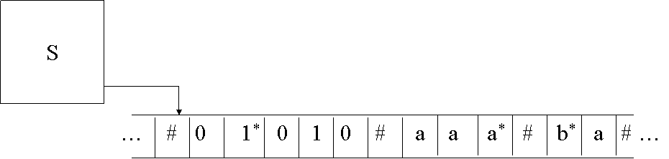
Multitape Machine
Equivalent Single Tape Machine:

Slide 67
Single Tape Equivalent
One final detail
If at any point S moves one of the virtual tape heads onto a #, then this action signifies that M has moved the corresponding head onto the previously unread blank portion of that tape.
To accommodate this situation, S writes a blank symbol on this tape cell and shifts the tape contents to the rightmost # by one, adds a new #, and then continues back where it left off

Slide 68
Nondeterministic TM
Replace the “DFA” part of the TM with an “NFA”
Each time we make a nondeterministic move, you can think of this as a branch or “fork” to two simultaneously running machines. Each machine gets a copy of the entire tape. If any one of these machines ends up in an accepting state, then the input is accepted.
Although powerful, nondeterminism does not affect the power of the TM model
Theorem: Every nondeterministic TM has an equivalent deterministic TM.
We can prove this theorem by simulating any nondeterministic TM, N, with a deterministic TM, D.

Slide 69
Non-deterministic TMs
Non-deterministic TMs ≡ Deterministic TMs
A TM can have non-deterministic moves:
δ(q,X) = { (q₁,Y₁,D₁), (q₂,Y₂,D₂), … }
Simulation using a multitape deterministic TM:
Control
Input tape
ID₁
ID₂
ID₃
ID₄
Marker tape
*
*
*
*
Scratch tape

Slide 70
Nondeterministic TM
Visualize N as a tree with branches whenever we fork off to two (or more) simultaneous machines.
Use D to try all possible branches of N, sequentially.
If D ever finds the accept state on one of these branches, then D accepts.
It is quite likely that D will never terminate in the event of a loop if there is no accepting state.
Search be done in a breadth-first rather than depth-first manner.
An individual branch may extend to infinity, and if we start down this branch then D will be stuck forever when some other branch may accept the input.
We can simulate N on D by a tape with a queue of ID’s and a scratch tape for temporary storage.
Each ID contains all the moves we have made from one state to the next, for one “branch” of the nondeterministic tree.
From the previous theorem, we can make as many multiple tapes as we like and this is still equivalent to a single tape machine. Initially, D looks like the following:

Slide 71
Nondeterministic TM
ID1 is the sequence of moves we make from the start state. The * indicates that this is the current ID we are executing.
We make a move on the TM. If this move results in a “fork” by following nondeterministic paths, then we create a new ID and copy it to the end of the queue using the scratch tape.
D
Scratch Tape
… ID1*
Queue of ID’s

Slide 72
Nondeterministic TM
For example, say that in ID1 we have two nondeterministic moves, resulting in ID2 and ID3:
D
Scratch Tape
… ID1* # ID2 # ID3

Slide 73
Nondeterministic TM
After we’re done with a single move in ID1, which may result in increasing the length of ID1 and storing it back to the tape, we move on to ID2:
D
Scratch Tape
… ID1 # ID2* # ID3

Slide 74
Nondeterministic TM
If any one of these states is accepting in an ID, then the machine quits and accepts.
If we ever reach the last ID, then we repeat back with the first ID.
Note that although the constructed deterministic TM is equivalent to accepting the same language as a nondeterministic TM, the deterministic TM might take exponentially more time than the nondeterministic TM.
It is unknown if this exponential slowdown is necessary. We’ll come back to this in the discussion of P vs. NP.
Theorem: Since any deterministic Turing Machine is also nondeterministic (there just happens to be no nondeterministic moves), there exists a nondeterministic TM for every deterministic TM.

Slide 75
Equivalence of TM’s and Computers
In one sense, a real computer has a finite amount of memory, and thus is weaker than a TM.
But, we can postulate an infinite supply of tapes, disks, or some peripheral storage device to simulate an infinite TM tape. Additionally, we can assume there is a human operator to mount disks, keep them stacked neatly on the sides of the computer, etc.
Need to show both directions, a TM can simulate a computer and that a computer can simulate a TM

Slide 76
Linear Bounded Automata (LBAs)
Linear Bounded Automata (LBAs) are the same as Turing Machines with one difference:
The input string tape space is the only tape space the machine is allowed to use

Slide 77

Linear Bounded Automata (LBAs)
A linear bounded automaton is a nondeterministic Turing machine M = (Q, Σ, Γ,δ, q0 , B,F), subject to the restriction that Σ must contain two special symbols [ and ], such that δ (qi ,[) can contain only elements of the form (qj , [,R), and δ (qi , ]) can contain only elements of the form (qj , ],L).
for some qf ∈ F, x1 , x2 ∈ Γ*.

Slide 78
Linear Bounded Automaton (LBA)
Input string
Working space
on tape
Left-end
marker
Right-end
marker
All computation is done between end markers

Slide 79
Linear Bounded Automata (LBAs)
Example languages accepted by LBAs:
LBA’s have more power than NPDA’s
LBA’s have also less power than Turing Machines

Slide 80
Linear Bounded Automata (LBAs)
LBA for L={a^{n}b^{n} | n>=1}

Slide 81
Computer Simulate a TM
This direction is fairly easy - Given a computer with a modern programming language, certainly, we can write a computer program that emulates the finite control of the TM.
The only issue remains the infinite tape. Our program must map cells in the tape to storage locations in a disk. When the disk becomes full, we must be able to map to a different disk in the stack of disks mounted by the human operator.

Slide 82
TM Simulate a Computer
In this exercise the simulation is performed at the level of stored instructions and accessing words of main memory.
TM has one tape that holds all the used memory locations and their contents.
Other TM tapes hold the instruction counter, memory address, computer input file, and scratch data.
The computer’s instruction cycle is simulated by:
Find the word indicated by the instruction counter on the memory tape.
Examine the instruction code (a finite set of options), and get the contents of any memory words mentioned in the instruction, using the scratch tape.
Perform the instruction, changing any words' values as needed, and adding new address-value pairs to the memory tape, if needed.

Slide 83
TM/Computer Equivalence
Anything a computer can do, a TM can do, and vice versa
TM is much slower than the computer, though
But the difference in speed is polynomial
Each step done on the computer can be completed in O(n²) steps on the TM (see book for details of proof).
While slow, this is key information if we wish to make an analogy to modern computers. Anything that we can prove using Turing machines translates to modern computers with a polynomial time transformation.
Whenever we talk about defining algorithms to solve problems, we can equivalently talk about how to construct a TM to solve the problem. If a TM cannot be built to solve a particular problem, then it means our modern computer cannot solve the problem either.

Slide 84
Summary
TMs == Recursively Enumerable languages
TMs can be used as both:
Language recognizers
Calculators/computers
Basic TM is equivalent to all the below:
TM + storage
Multi-track TM
Multi-tape TM
Non-deterministic TM
TMs are like universal computing machines with unbounded storage

